Slide 1
Investing in Canada and Business Succession
October 14, 2021

Slide 2
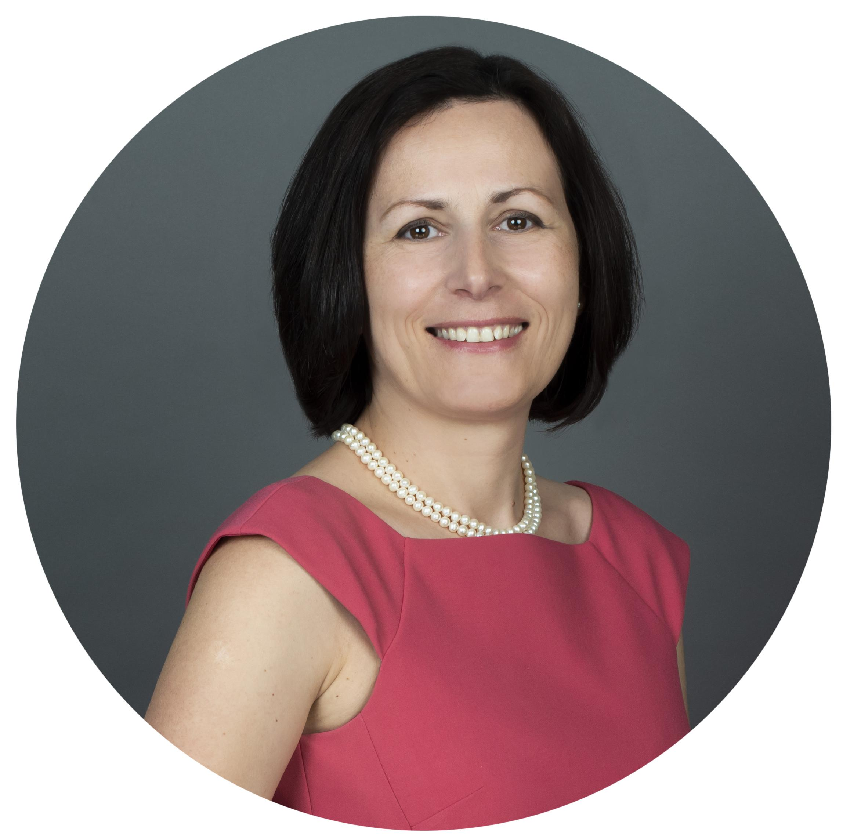
With you Today
Cosmina Morariu
Senior Business Immigration Manager/Lawyer
Canada / Toronto

Slide 3
Overview of the Business Permanent Residence Applications
Overview of the Business Temporary Residence Applications
AGENDA

Slide 4



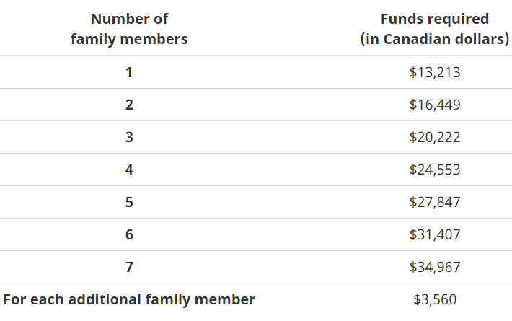
Overview of the Business Permanent Residence Applications
THE START-UP VISA PROGRAM
FR
EN
English/French
Proficiency
Sufficent
Settlement Funds
Commitment From
Designated
Organization
Have A Qualifying
Business
The applicant must meet the minimum level of CLB 5 in English (IELTS general training test) or in French (TEF test) in all four areas: speaking, reading, listening, and writing;
The applicant must have sufficient settlement funds based on the number of family members, as shown in this table:
The applicant must receive a commitment from a designated organization confirming its support of the applicant’s business idea and venture to be developed. The 3 types of designated organizations are:
The applicant must set-up
a qualifying business,
which includes both:
An ownership requirement
The applicant must hold 10% or more of the voting rights and, together with the designated organization, they must hold 50%
or more of the voting rights;
International English Language Testing System (IELTS General Training)
Venture Capital Funds
Minimum investment of CAD 200,000
Angel Investor Groups
Minimum investment of CAD 75,000
Business Incubators
Need to complete an incubation
A Canadian operations requirement
The applicant must have a venture in which the applicant provides active and ongoing management from within Canada, for which an essential part of its operations is conducted in Canada, and that is ultimately incorporated in Canada.
Test d'évaluation de francais
Each organization has its
own specific requirements
to onboard applicants.

Slide 5


IMPLIED CRITERIA OF THE
START-UP VISA
Types of Business
Need an innovative business proposal that can compete on a global scale, which means to have a concrete problematic to resolve, a significant new solution/advantage proposed to fix the problem, and a targeted market that has potential both in Canada and abroad.
Applicant’s Background and Group Applications
The innovative business idea needs to be linked to the applicant’s own professional background and managerial/entrepreneurial experience. Same goes for group applications, not only the business needs to be a fit for each member, but the members of the group need to know each other and ideally have collaborated already, as an unfit member would jeopardize chances of approval for the entire group’s applications.
Applicant’s Active Involvement
The SUV program is not a passive investment program. Applicants are required to have an active participation in the business proposal and in the development of the business venture.

Slide 6
Provincial Nominee Entrepreneur Programs
Requirements | To be eligible for this program, there are minimum requirements that vary depending on the province of destination; Active management of the business; Minimum 2 years of managerial or ownership experience within the last 5 years; Net worth of CAD$300,000 to CAD$800,000; Personal investment of CAD$100,000 to CAD$600,000; Buy a local business that has been in existence for 3-5 years and is profitable, or start a new one; Create jobs for Canadian citizens/permanent residents; Minimum English/French language requirement, but low threshold; and In effect in all provinces across Canada.
Dependants | Spouse & children under 22.
Best Profile Candidate | Entrepreneurs who are ready to invest in and actively manage a business in any province across Canada as a pathway to permanent residence and commit to spending at least 75% of the time in Canada managing the business.
Processing times involved | Approximately 12 months to obtain a work permit and start managing the business in Canada; Approximately 18-36 months monitoring of the business by the provincial government; and Approximately 12-15 months to obtain permanent residence based on the provincial approval.

Slide 7
Overview of the Business Temporary Residence Applications
The Intra-Company Transfer (ICT) Start-Up Program
Requirements | To be eligible under this program, the company: Must generally secure physical premises to house the Canadian operation, particularly in the case of specialized knowledge. However, in specific cases involving senior managers or executives, it would be acceptable that the address of the new start-up not yet be secured; for example, the company may use its counsel’s address until the executive can purchase or lease a premise. The company must furnish realistic plans to staff the new operation. The company must have the financial ability to commence business in Canada and compensate employees. When transferring executives or managers, the company must demonstrate that it will be large enough to support executive or management function. When transferring a specialized knowledge worker, the company must demonstrate that it is expected to be doing business and ensure that work is guided and directed by management at the Canadian operation.
Dependants | Spouse & children under 22.
Best Profile Candidate | Senior manager/executive or specialized worker, with at least one year of experience outside Canada.
Processing times involved | The processing time for the work permit depends on the filing location and can run from 1-4 months.

Slide 8
The Global Talent Stream, Category A
Requirements | To be eligible under this program, the company: Have a designated referral partner, who will be able to vouch for the company in terms of legitimacy and operating in Canada; The company has a focus on innovation and is capable of scaling up; The company is seeking to fill a unique and specialized position in the company; The company has identified a qualified foreign worker for potential hire into that unique and specialized position; and The company requires a labour market benefits plan.
Dependants | Spouse & children under 22.
Best Profile | Innovative company seeking to fill a very limited number of unique or specialized positions
Processing times involved | The processing time for the Labour Market Impact Assessment is approximately 1 month. The processing time for the work permit depends on the filing location and can run from 1-4 months.

Slide 9
Approved Applications Data
Intra - company transferees (C12) Work Permit Applications (including extensions) Approved between 2018 and May 31, 2021, Broken Down by Country of Citizenship (in Persons)
Country of Citizenship | 2018 | 2019 | 2020 | 2021 (Jan-May) | Total
India | 10,883 | 15,323 | 10,169 | 6,824 | 43,199
United Kingdom and Overseas Territories | 1,089 | 1,035 | 599 | 330 | 3,053
People's Republic of China | 610 | 691 | 623 | 411 | 2,335
France | 709 | 727 | 479 | 266 | 2,181
Federal Republic of Germany | 555 | 521 | 321 | 174 | 1,571
Japan | 499 | 352 | 271 | 187 | 1,309
Number of Start-up Business and Provincial/Territorial Nominees Applications Approved, Broken Down by Country of Citizenship and Calendar Year between 2018 and May 31, 2021 (In Persons)
Country of Citizenship | 2018 |  |  | 2019 |  |  | 2020 |  |  | 2021 (Jan-May)
 | Provincial/Territorial Nominees | Start-up Business | Total | Provincial/Territorial Nominees | Start-up Business | Total | Provincial/Territorial Nominees | Start-up Business | Total | Provincial/Territorial Nominees | Start-up Business | Total
India | 18,756 | 37 | 18,793 | 19,226 | 73 | 19,299 | 13,664 | 34 | 13,698 | 5,392 | 24 | 5,416
People's Republic of China | 9,706 | 32 | 9,738 | 10,496 | 82 | 10,578 | 5,624 | 12 | 5,636 | 2,106 | 24 | 2,130
Philippines | 7,918 |  | 7,918 | 8,633 |  | 8,633 | 2,886 |  | 2,886 | 1,314 |  | 1,314
Nigeria | 3,256 |  | 3,256 | 2,786 | 11 | 2,797 | 2,743 | 5 | 2,748 | 640 | 1 | 641
Korea, Republic of | 2,247 | 7 | 2,254 | 3,278 | 3 | 3,281 | 1,774 |  | 1,774 | 777 |  | 777
Pakistan | 1,793 | 2 | 1,795 | 1,689 | 4 | 1,693 | 894 | 1 | 895 | 110 |  | 110
Egypt | 1,241 |  | 1,241 | 907 | 4 | 911 | 334 |  | 334 | 91 |  | 91
Iran | 1,052 | 5 | 1,057 | 1,179 | 71 | 1,250 | 1,034 | 31 | 1,065 | 292 | 32 | 324
United States of America | 995 | 9 | 1,004 | 1,117 | 19 | 1,136 | 956 |  | 956 | 361 | 9 | 370
Ukraine | 993 | 8 | 1,001 | 1,057 | 12 | 1,069 | 601 | 1 | 602 | 265 | 4 | 269
United Kingdom and Overseas Territories | 982 | 8 | 990 | 1,224 | 14 | 1,238 | 877 | 10 | 887 | 343 |  | 343
Bangladesh | 983 | 2 | 985 | 818 | 9 | 827 | 463 |  | 463 | 156 |  | 156
Socialist Republic of Vietnam | 889 | 49 | 938 | 1,088 | 123 | 1,211 | 658 | 38 | 696 | 354 | 26 | 380
Brazil | 898 | 6 | 904 | 1,929 | 23 | 1,952 | 1,575 | 5 | 1,580 | 817 | 2 | 819

Slide 10
Setting up a business in Canada through……
Business Succession and Succession Matching

Slide 11


With you Today
Alison Anderson
CEO & Founder

Slide 12

Real-time data on business succession across Canada
Review international data for source countries
Gaps between Canada’s immigration efforts & existing solutions for business communities
Preparing a business for a transition through a provincial nominee program
Advice on where to find resources
AGENDA

Slide 13

Notes:
I would love the opportunity to talk to you about this expansion/ and our other programming./

Slide 14
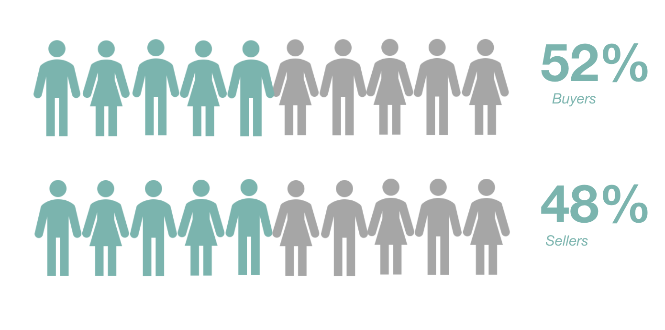
REAL-TIME DATA
Business Succession Trends
Historic Signup Rates
Over the past ten years, our signups have historically been 52% buyers and 48% sellers

Slide 15
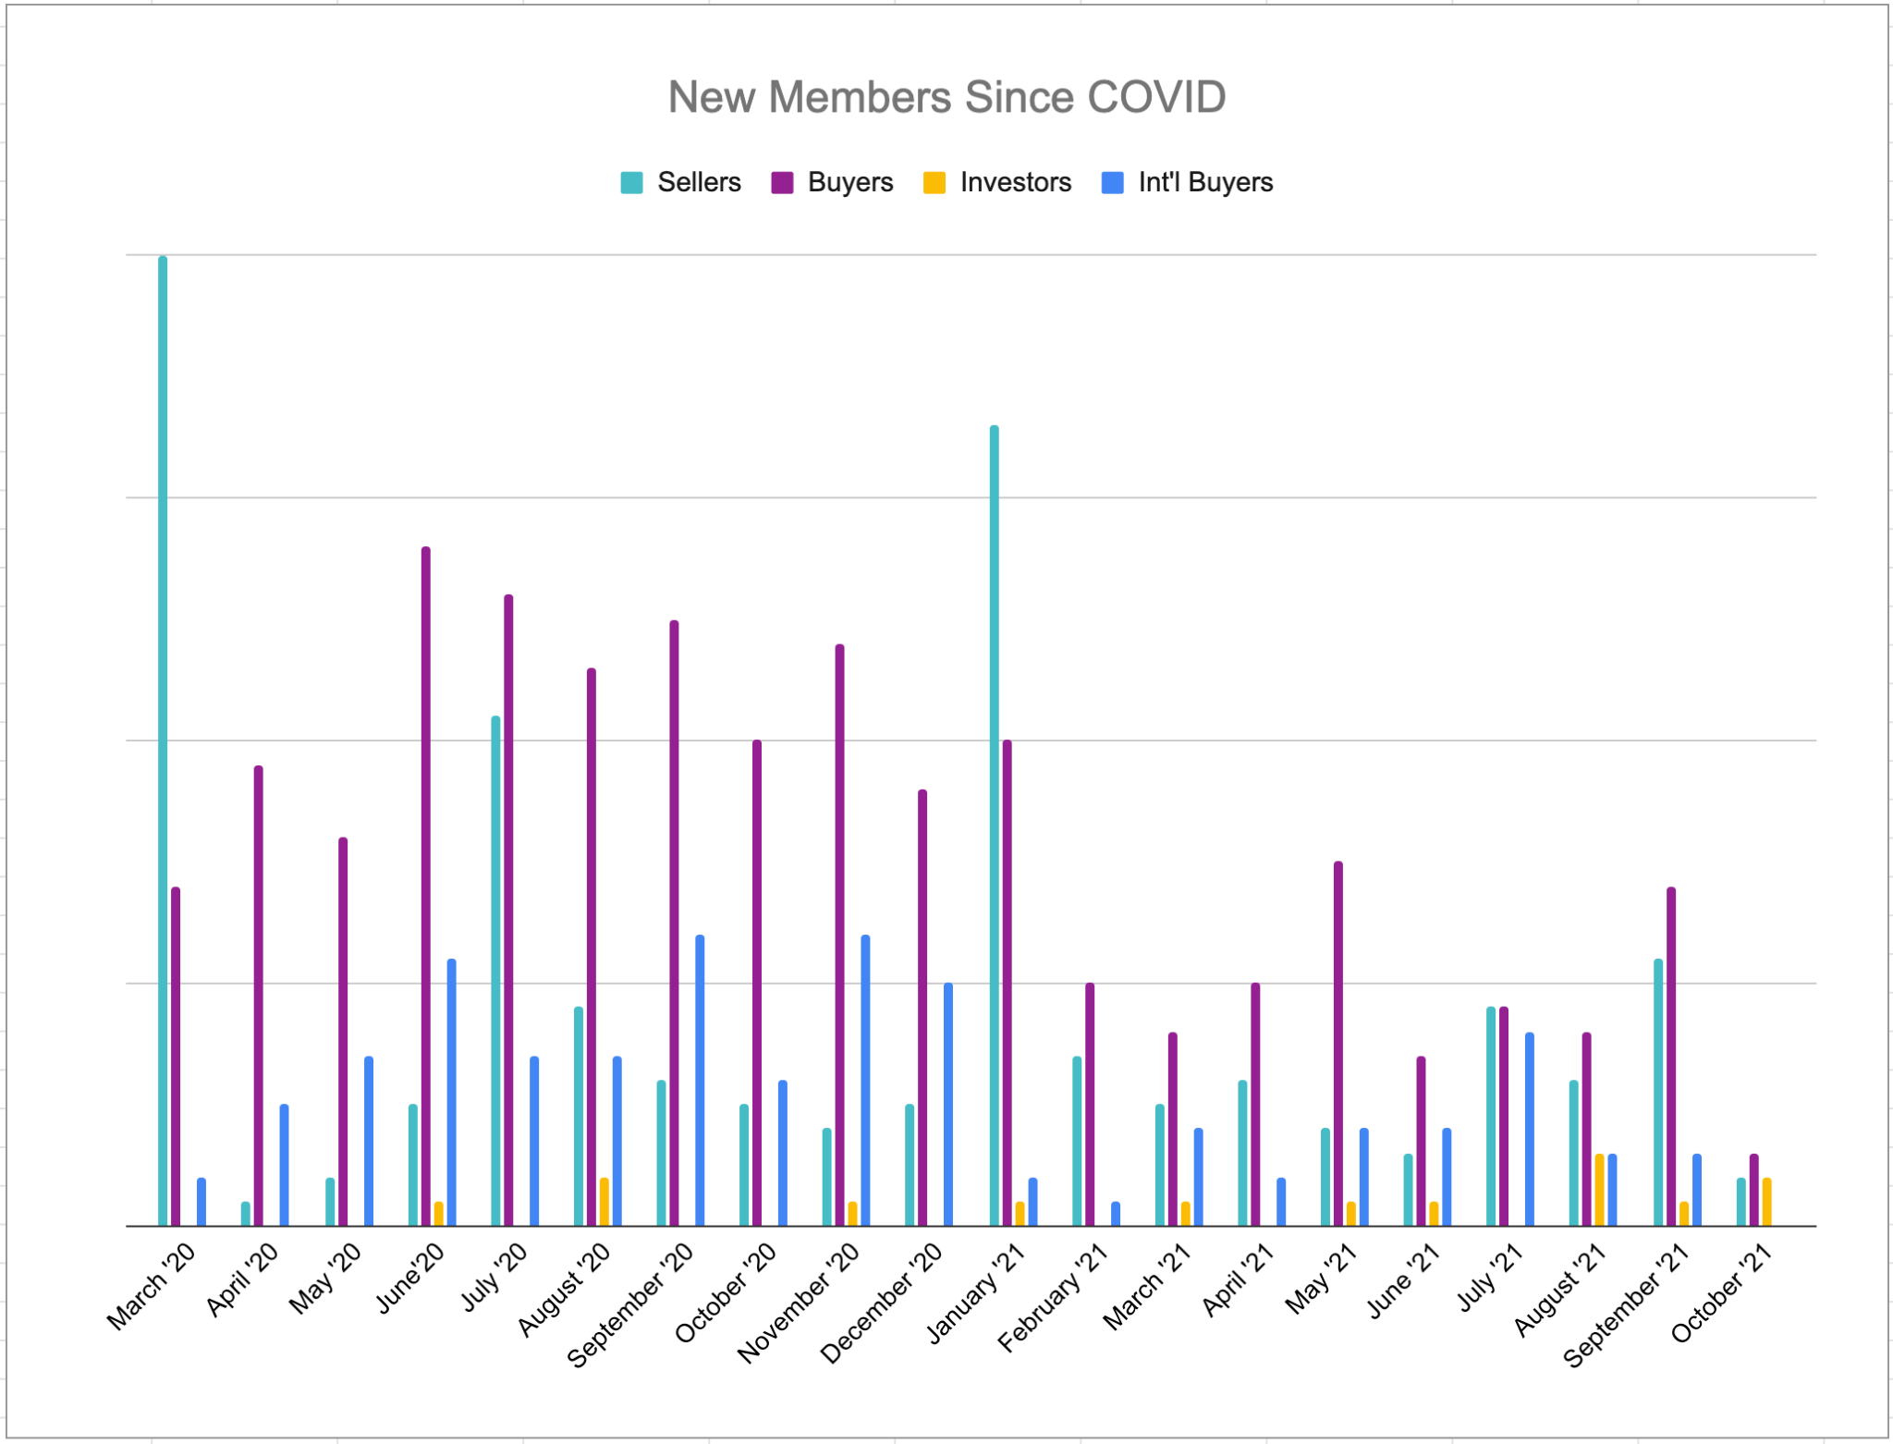
REAL-TIME DATA
Business Succession Trends
Market Shift
Since March 2020, the market has shifted to only 29.4% of our signups being sellers

Slide 16
REAL-TIME DATA
Business Succession Trends
Market Shift
Since March 2020, the market has shifted to only 29.4% of our signups being sellers

Slide 17


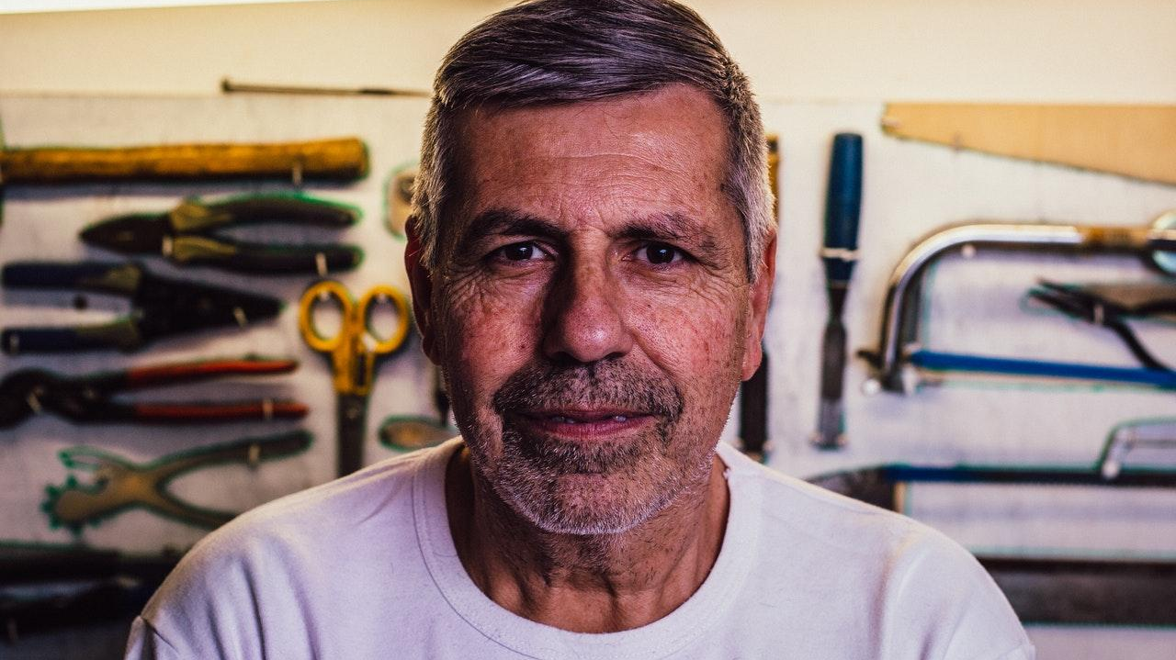
REAL-TIME DATA
Business Succession Trends
New Pain Points
New pain points for sellers and buyers of small and medium-sized businesses during the COVID-19 pandemic.

Slide 18
REAL-TIME DATA
Buyer Pain Points
Finding Financing
Is the number one barrier to purchasing a business. COVID has made access to capital extremely challenging from chartered banks.

Slide 19
REAL-TIME DATA
Seller Pain Points
Debt
According to the Canadian Federation of Independent Business, the average Canadian business took on almost $170,000 in additional debt during COVID
According to the Government of Canada’s website, 897,617 businesses took a CEBA or RRRF loan. A line of credit of up to $60,000. Repayments scheduled to start on January 1, 2023.

Slide 20
REAL-TIME DATA
Seller Pain Points
Misconception
During our seller engagement, we discovered that the number one barrier to selling a business during the pandemic is sellers did not think individuals would be interested in purchasing a business right now.

Slide 21
Addressing Pain Points
Filling the Gaps
Finding Financing
International buyers are required to invest a certain amount, depending on the province, to purchase a business through the provincial nominee program.
Debt
The Federal Government needs to take action on the timelines for repayment or amount forgiven on the CEBA and RRRF loans in order to make more businesses a feasible investment.
Misconception
As shown in our sign-up data, it is a really strong market right now for business owners looking to sell based on the number of domestic and international buyers looking for businesses. This message needs to be disseminated in the business community.

Slide 22
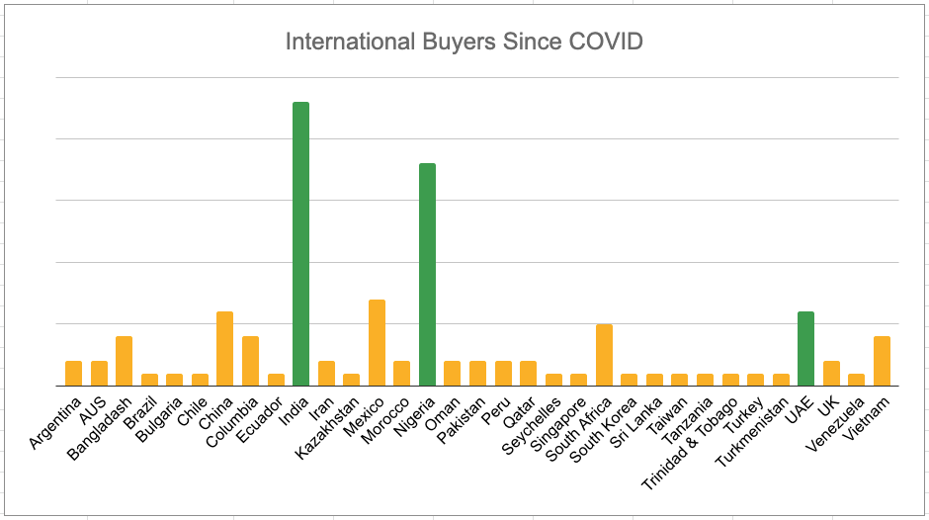
REAL-TIME DATA
Source Countries

Slide 23
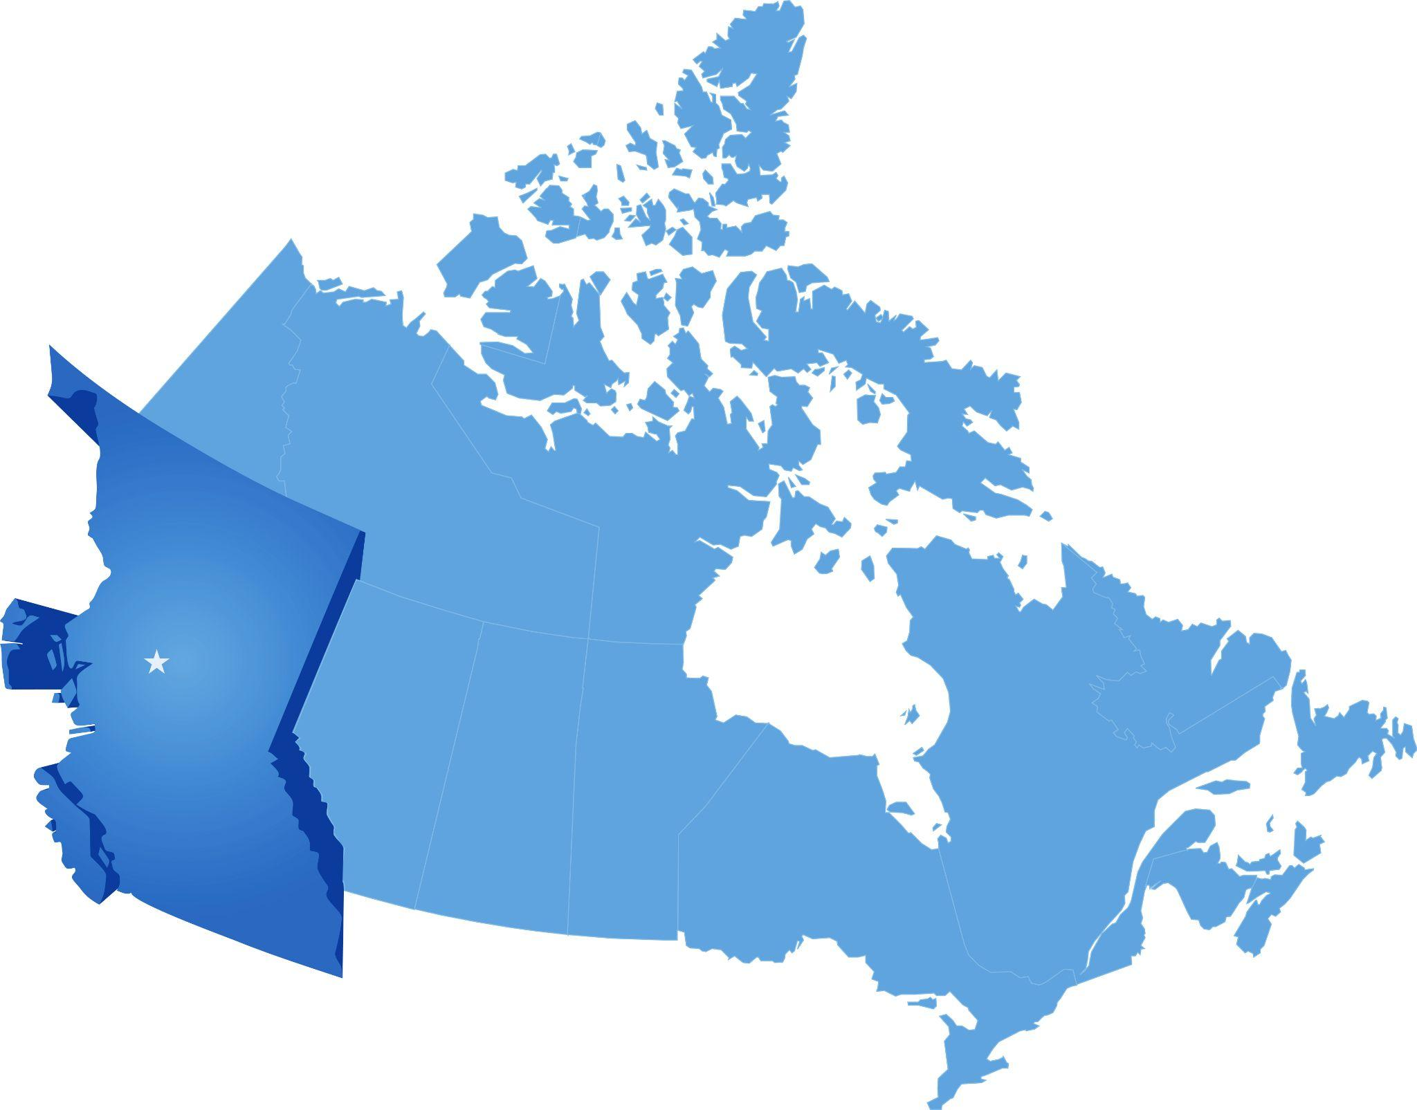
British Columbia

Slide 24
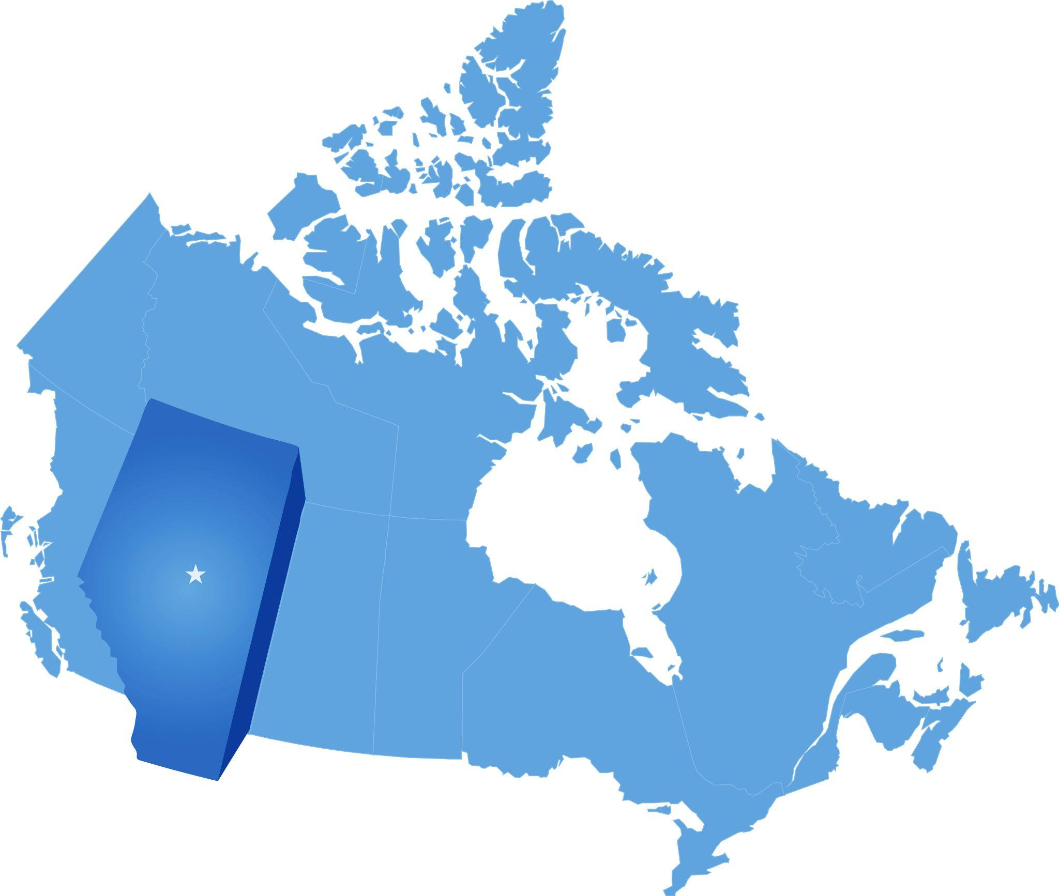
Alberta

Slide 25
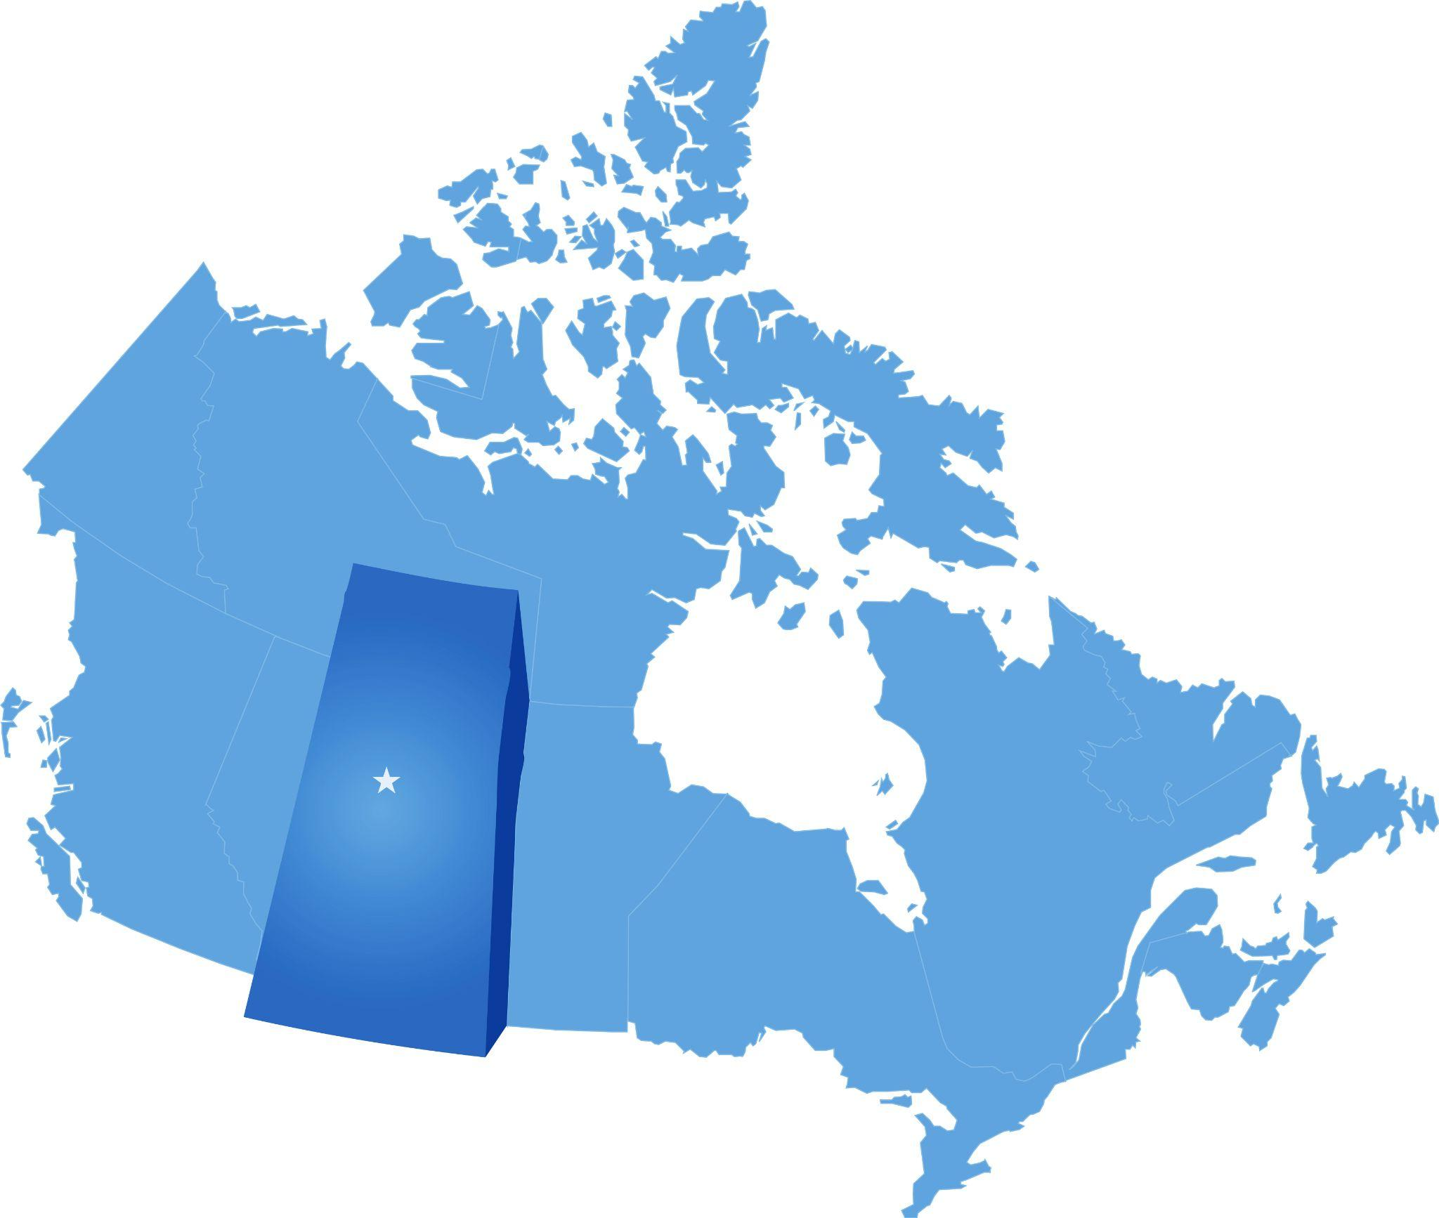
Saskatchewan

Slide 26
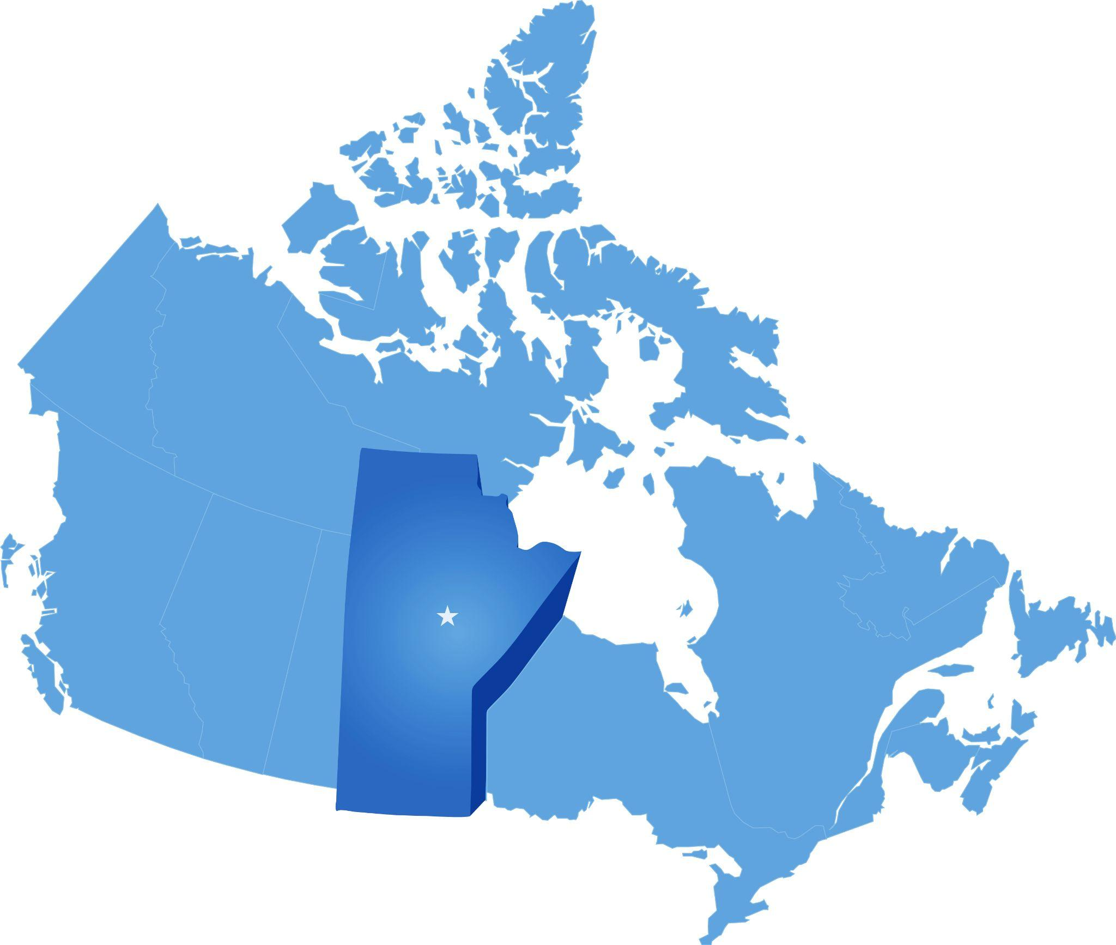
Manitoba

Slide 27
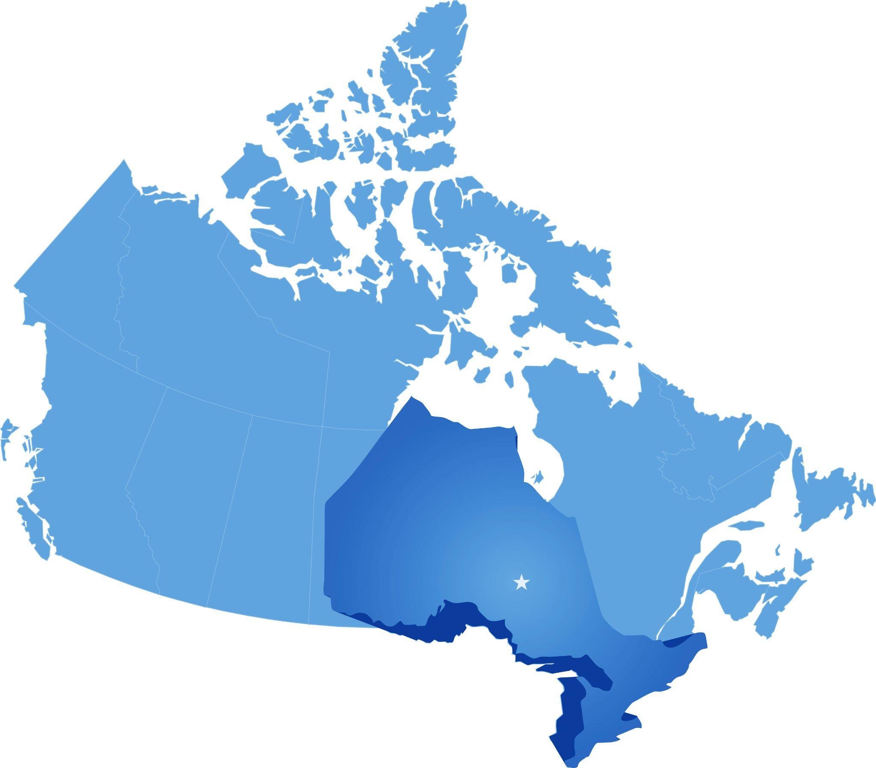
Ontario

Slide 28
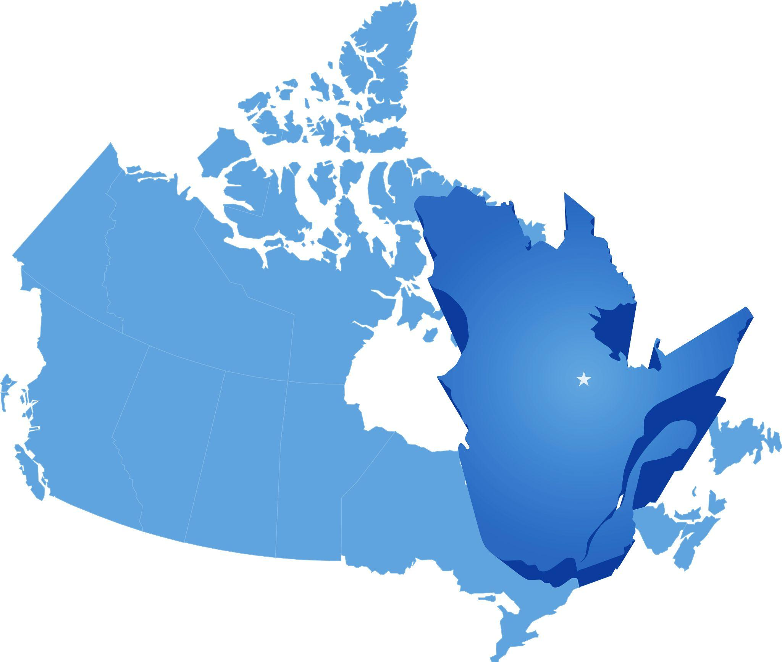
Québec

Slide 29
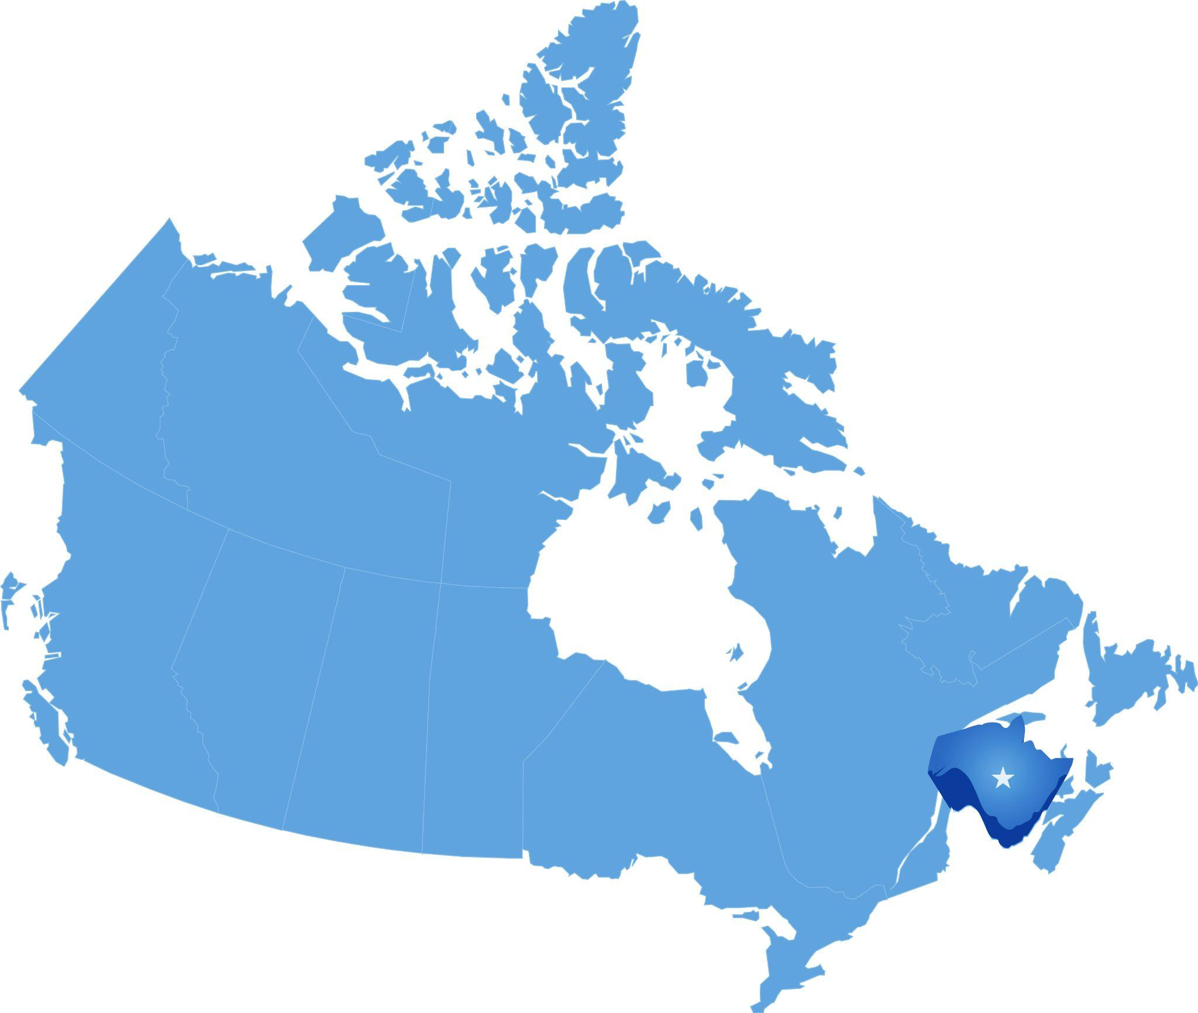
New Brunswick

Slide 30

Prince Edward Island

Slide 31
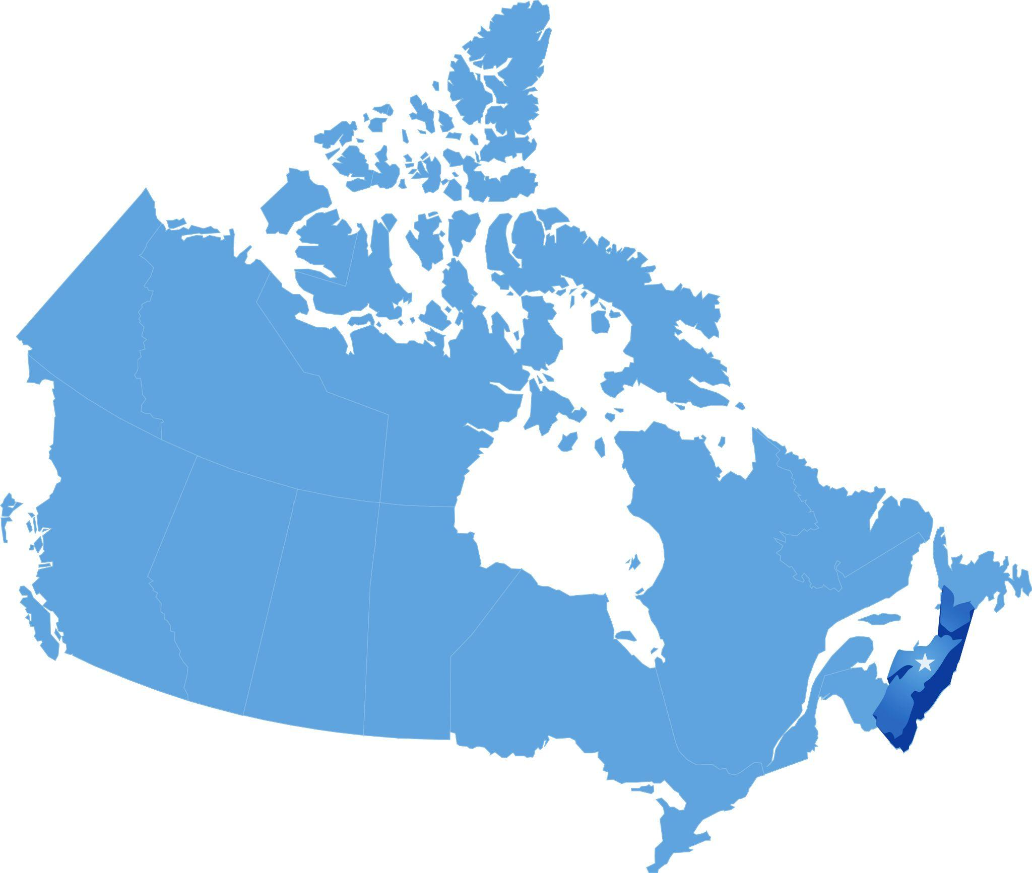
Nova Scotia

Slide 32
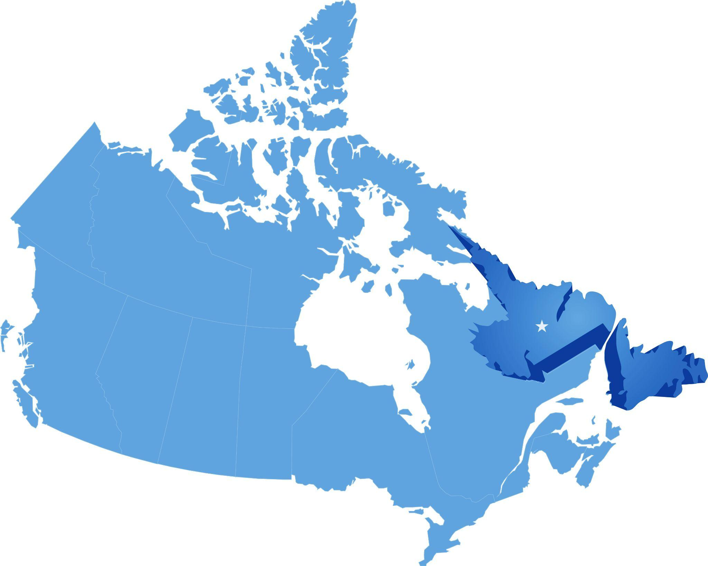
Newfoundland
& Labrador

Slide 33
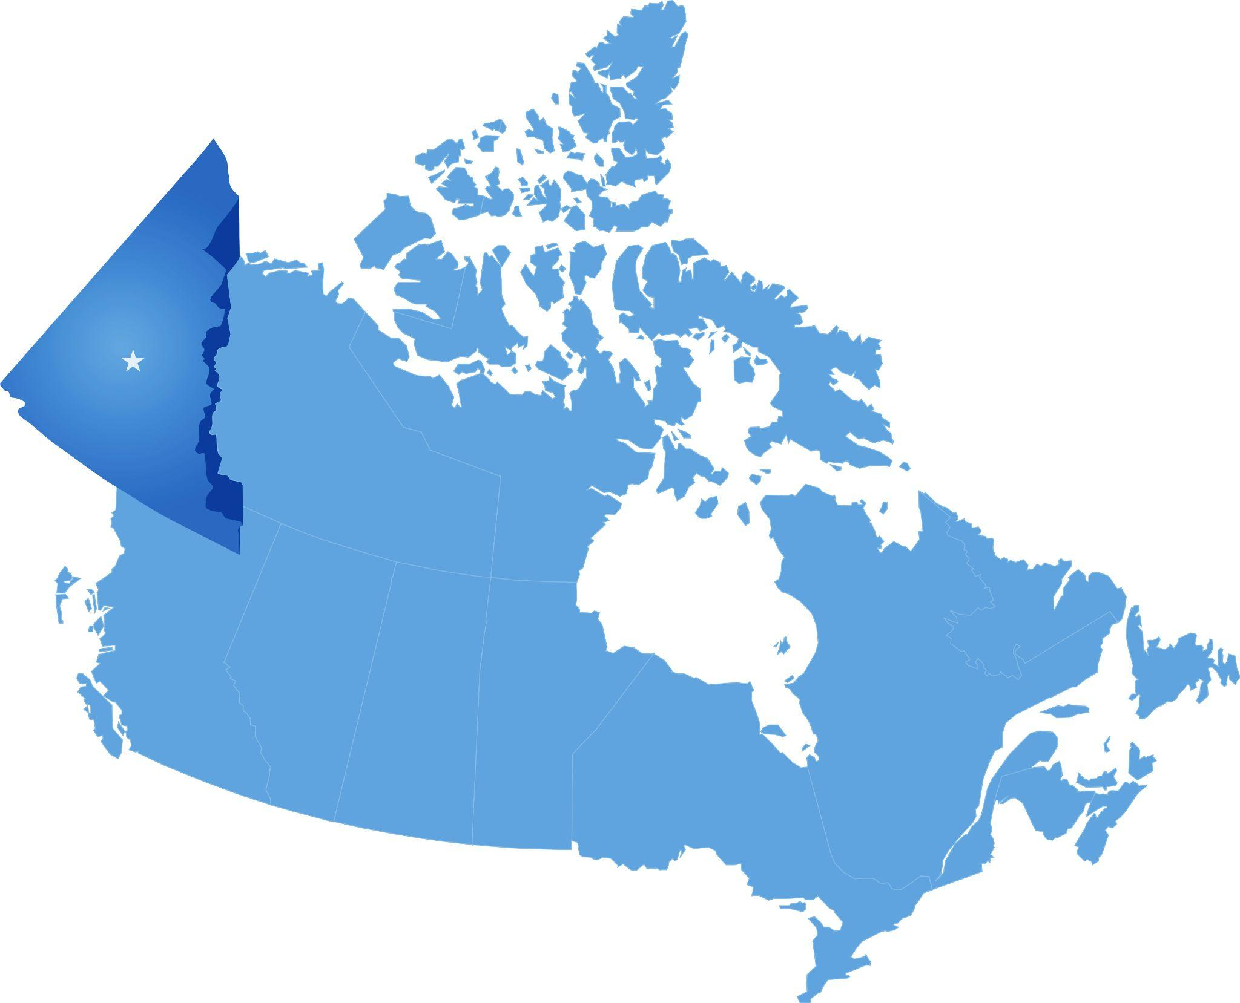
Yukon

Slide 34
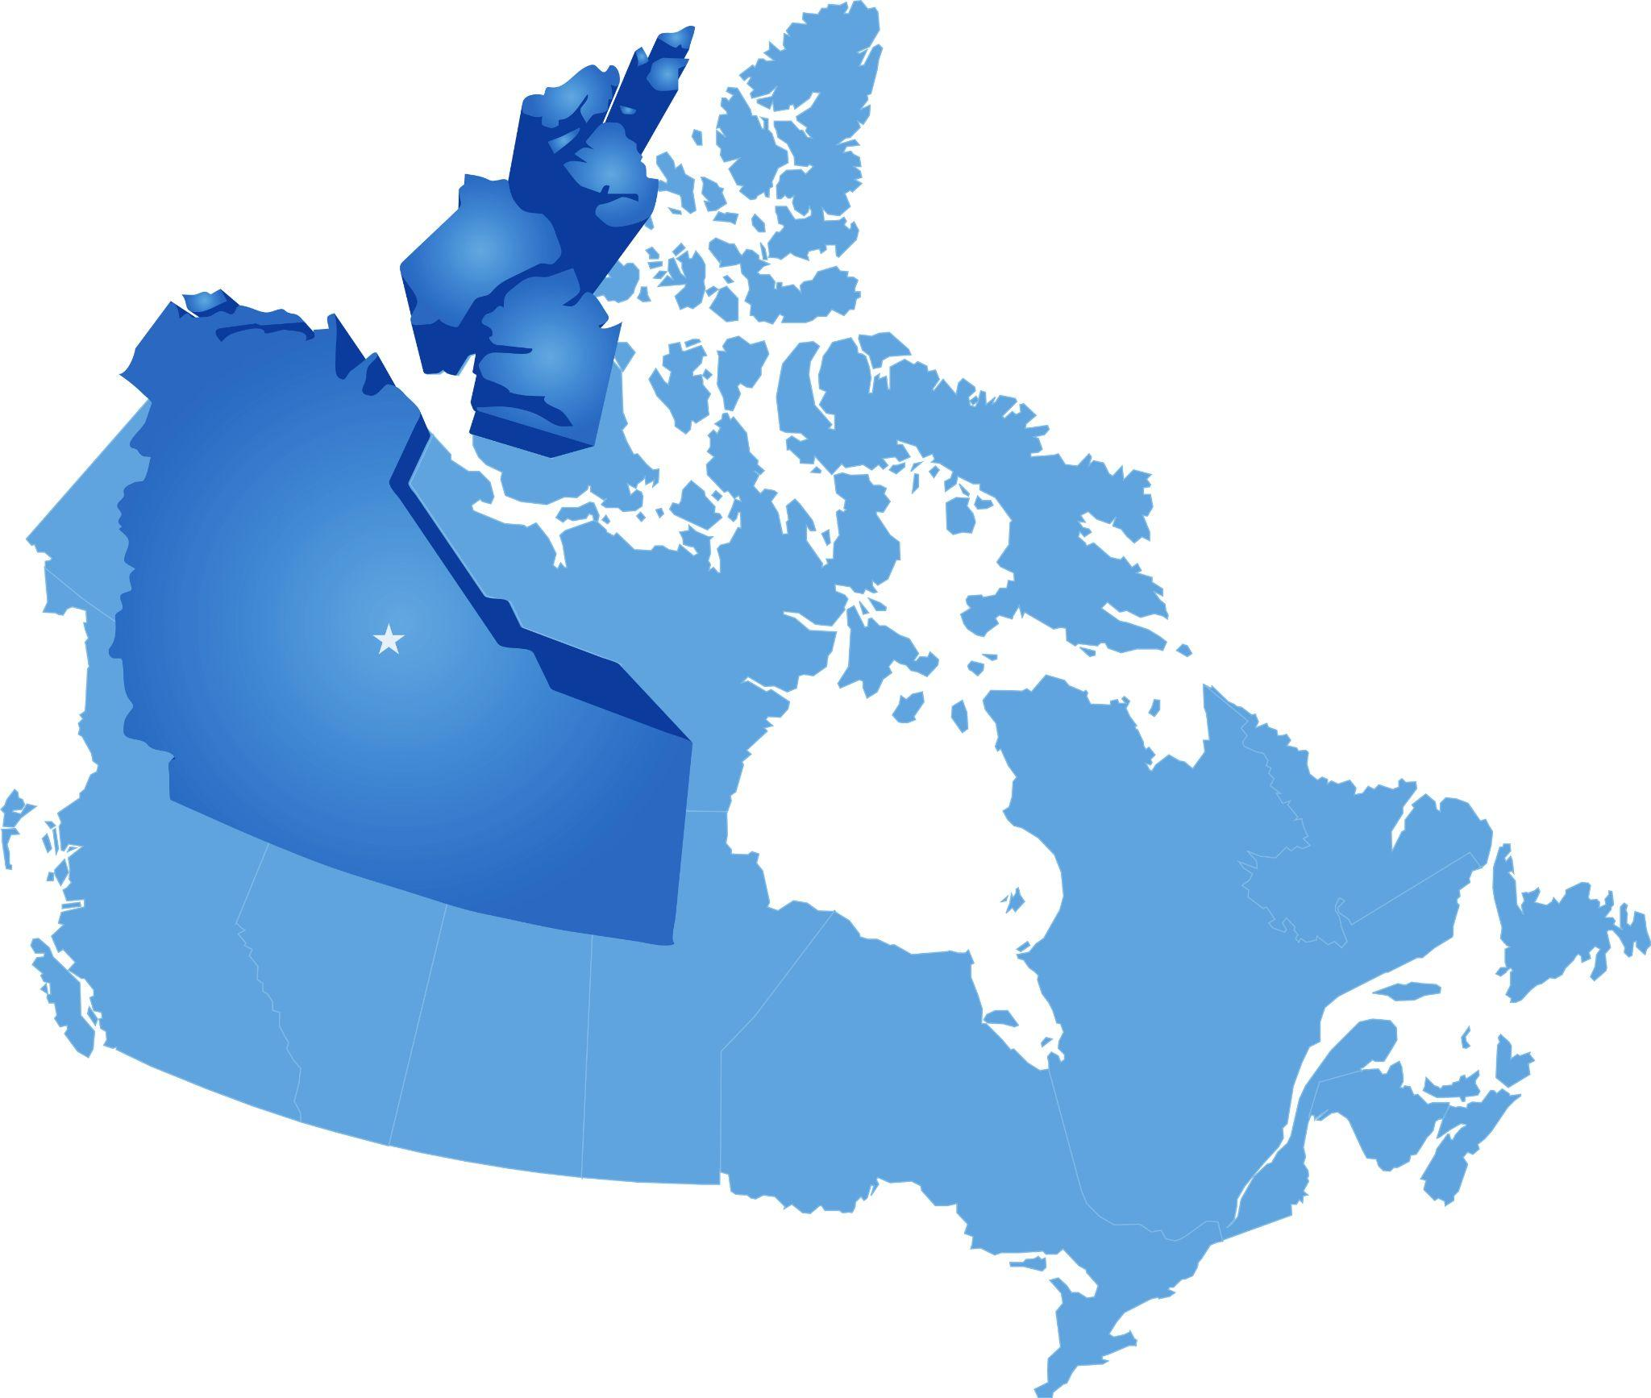
Northwest Territories

Slide 35
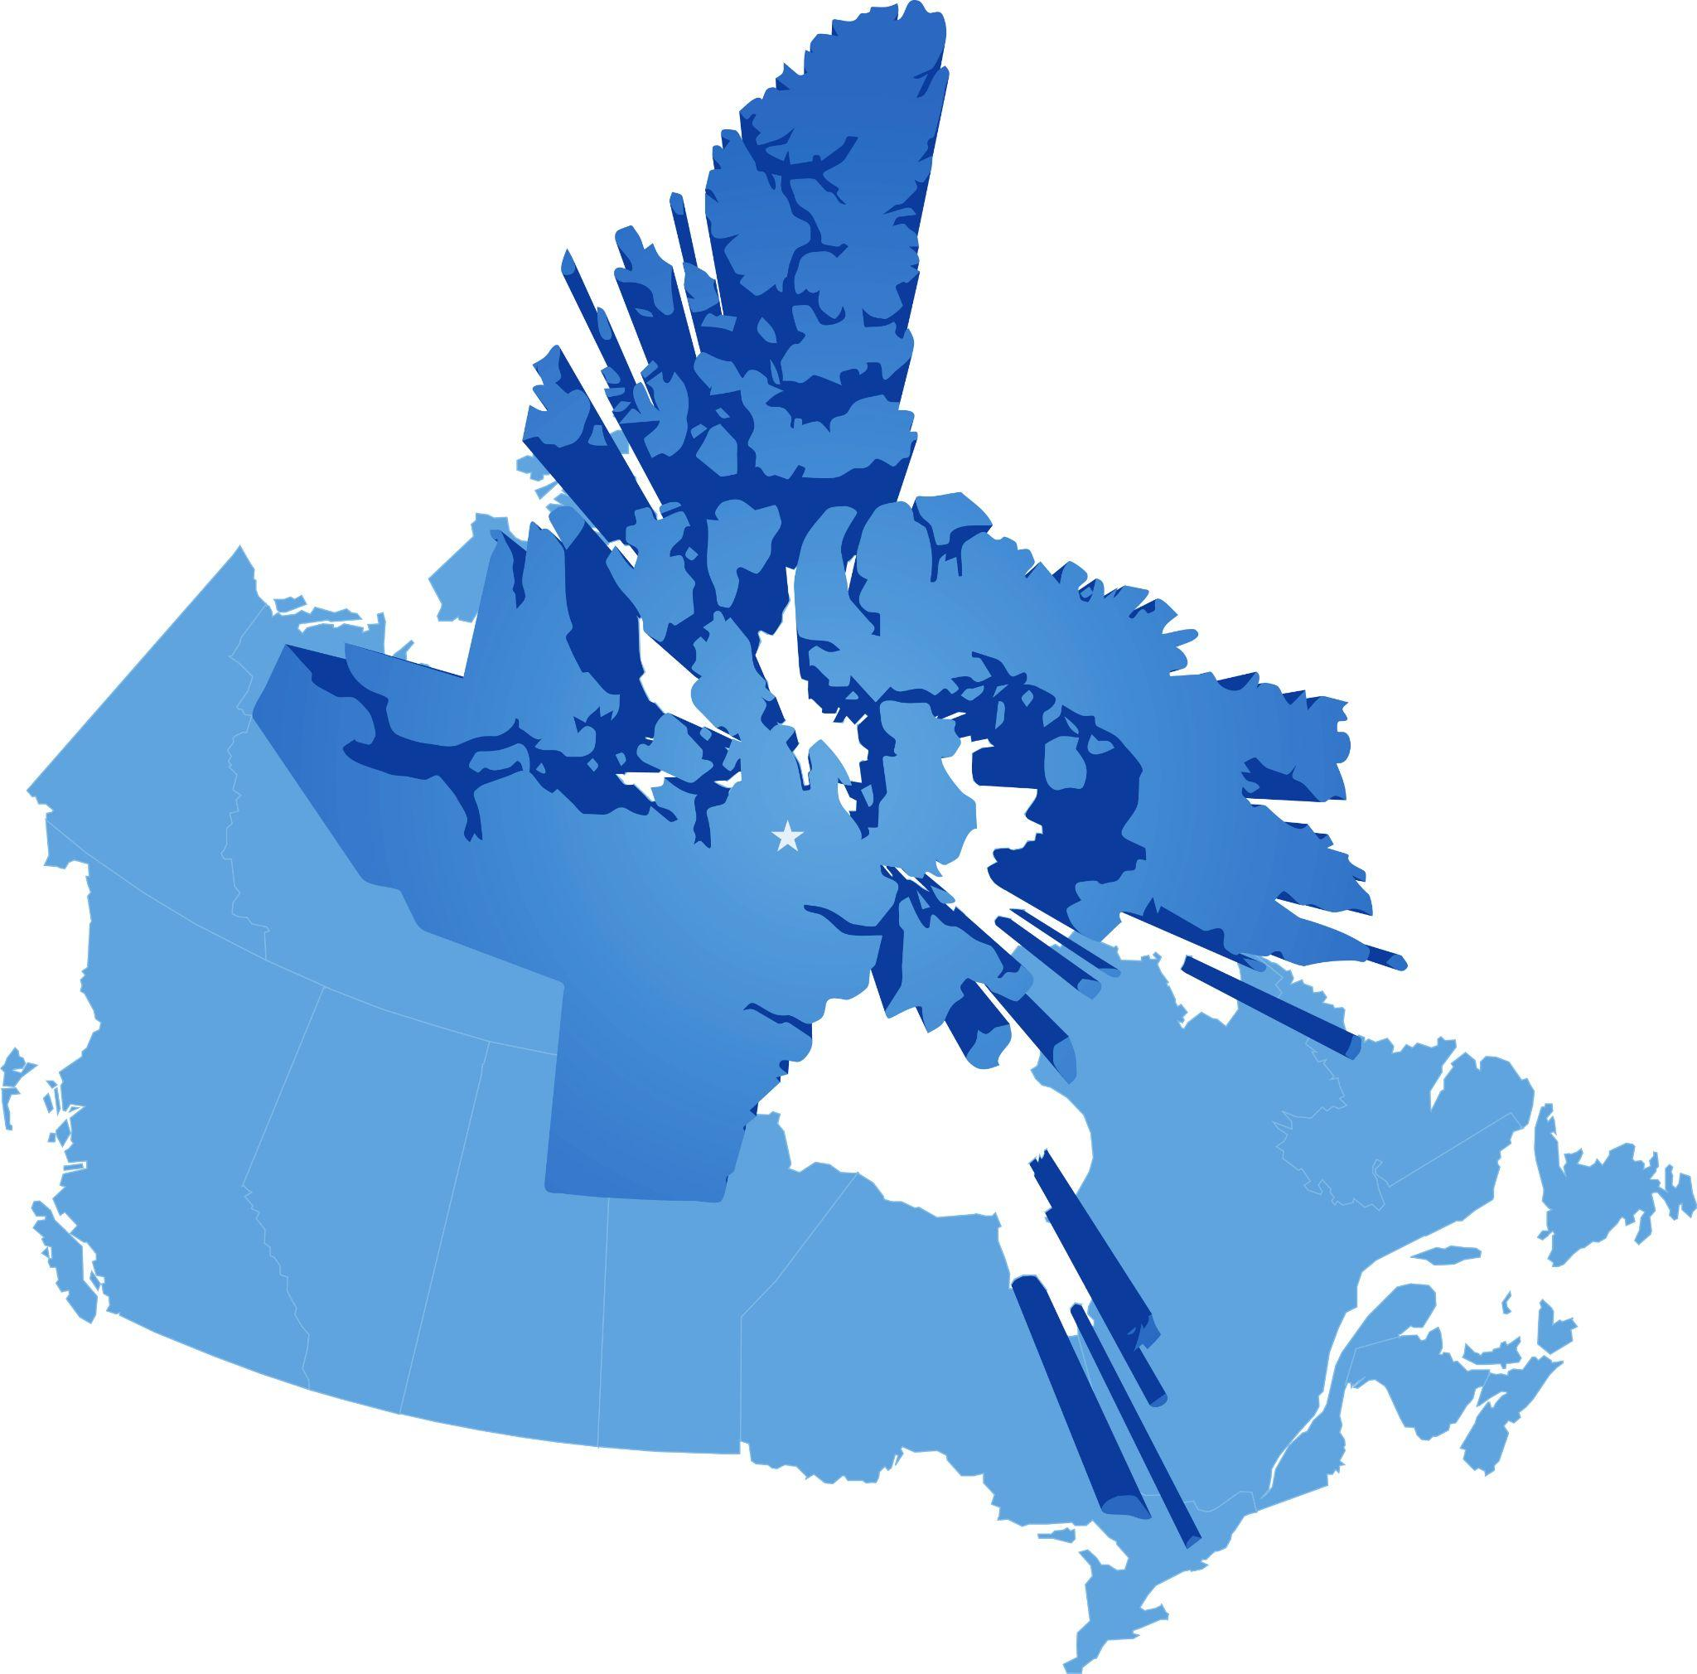
Nunavut

Slide 36
Is it a good fit for you?
Prepare for a transition
through a PNP
Eligibility
Is your business eligible to sell to an international buyer based on your location, industry and other factors?
Timelines
Do you have more than 24-months before you want to sell your business?
Mentorship
Are you willing to stay on and mentor the new buyer?

Slide 37

Resources Available
PNP Eligibility Questionnaire
30-Minute Consultation
Notes:
Yet/ according to the CFIB, less than 8 percent have a formal succession plan.

Slide 38
THANK YOU
QUESTIONS?

